Slide 1

MBARARA REGIONAL REFERRAL HOSPITAL JULY-SEPTEMBER 2020 PERFORMANCE REVIEW
6TH NOVEMBER 2020

Slide 2
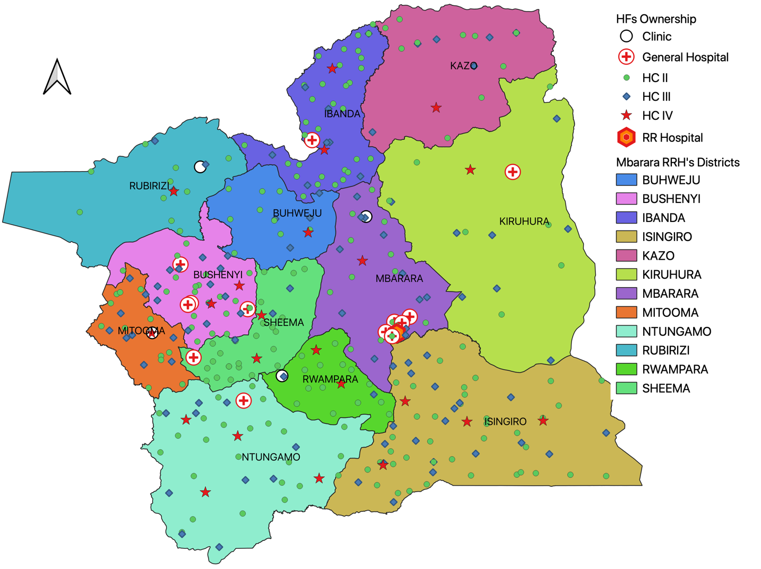

Slide 3
About Mbarara Regional Referral Hospital.
MRRH is located in the center of Mbarara City [about 270 km from Kampala] next to Mbarara University of Science and technology along the Mbarara - Kabale – Fort Portal highway.
MRRH serves an estimated catchment population of about 4 million people coming mainly from the districts of Ankole sub-region including Mbarara, Bushenyi, Sheema, Ntungamo, Kiruhura, Ibanda, Buhweju, Isingiro, Mitooma and Rubirizi. Additionally, the Hospital also receives referrals from the districts neighboring Ankole sub-region including mainly Rukungiri, Lyatonde, Kabale, Kamwegye and Rakai: The Hospital also receives clients referred from neighboring states of Tanzania, Democratic republic of Congo (DRC) & Rwanda.

Slide 4
Government to Government (G2G) Funding Mechanism
The Mbarara RRH pilot project is intended to pave way for a longer-term vision of transforming the RRH into one of the centers of excellence serving as sustainable platforms for technical assistance, service quality improvement delivering and monitoring of health programs in Ankole sub region of the SW region of Uganda
Purpose and outcomes of the USAID G2G
To pilot the concept of RRHs as centers of excellence in HIV service delivery including HIV/TB.
To promote learning and adaptation to inform successful scale-up of the G2G funding mechanism.

Slide 5
The outcomes targeted include;
Improved availability, accessibility, organizational capability to deliver quality HIV services including TB
Strengthened systems to improve sustainability and accountability
Collaborating, Learning and Adapting (CLA) throughout the life of the project by use of quality improvement strategies including data to support program management decisions that may support the success of the pilot and any future pilot scale-up
Maintain PEPFAR specific data management, analysis, and reporting systems. These, in the long term are set to improve the coverage, quality, responsiveness and sustainability of Uganda’s health service delivery and the health status of Ugandans

Slide 6
Approaches used to achieve G to G targeted results
With the support from USAID supported partners, MRRH leadership is strengthening the capacity of health workers to oversee specific technical areas as they provide the continuum of HIV/AIDS and TB-HIV care.
Special attention is given to HIV Testing and counselling Services (HTS), client Retention, viral suppression and Prevention of mother-to-child transmission of HIV (PMTCT) services.
Additionally, efforts to strengthen the MRRH management and accountability systems have been enhanced so as to provide the cornerstone of the RRH’s long-term sustainability

Slide 7
KEY RESULT AREAS
HIV TESTING SERVICES
ART CARE & TREATMENT
VIRAL LOAD TESTING AND ART RETENTION
TB/HIV
KP/PP SERVICES
MNCH SERVICES
MATERNITY SERVICES
OUT/IN PATIENT SERVICES
COVID19 UPDATES

Slide 8
HIV TESTING SERVICES

Slide 9
HTS performance trends across the Q1, Q2, Q3 & Q4(Oct 2019-Sept 2020)

Slide 10
HTS JULY-SEPT 2020

Slide 11
Newly identified positives Vs target
Comments
Our weekly target was 23
We improved our HIV case identification in the last 4 weeks where the weekly target was achieved

Slide 12
Linkage rates across the quarters Oct-2019-Sept 2020
Our Linkage rates have improved in Q4 from 87% in Q3 to 96% in Q4 due to various interventions put in place.

Slide 13
Table showing yield at different testing points from Oct 2019 to Sept 2020
Modality | HTS_TST | TST_POS | Yield
Other PITC (incl tests for TB pts | 9,320 | 260 | 2.8%
Pediatric | 152 | 7 | 4.6%
Index Facility Client testing | 388 | 268 | 69.1%
Index Community Client testing | 391 | 190 | 48.6%
MOBILE COMMUNITY | 228 | 7 | 3.1%
PMTCT (ANC 1 only) | 1835 | 51 | 2.8%
PMTCT Post ANC Pregnancy/L&D/BF | 1,991 | 7 | 0.4%
VCT COMMUNITY | 344 | 04 | 1.2%
Grand Total | 14,649 | 794 | 5.4%
Comments
During the year, 14,649 clients received HIV Testing with 794(5.4%) clients testing Positive
Index testing(Both Community and Facility yielded most at 48.6% and 69.1% respectively)
Index testing contributed 58% of the total Positives

Slide 14
HTS SELF TESTING Oct-2019-Sept 2020

Slide 15
HTS RECENCY TESTING Oct 2019-Sept 2020
RRH conducted 72 recency HIV tests, of which, 07 were recent, 64 were long term and 01 turned negative

Slide 16
ART CARE&TREATMENT

Slide 17
Newly enrolled clients and clients current in care across the quarters
Net Loss 235
Transferred out 205(87.2%)
Died 09(3.8%)
Lost to follow-up 21(9%)

Slide 18
Newly enrolled on ART by district (July-Sept 2020)

Slide 19
ACTIVE CLIENTS by Regimen Line Sept 2020
Comments
1st line regimen accounted for 90% of our active clients , 9.84% for 2nd line and 0.16% for 3rd line
Male clients seem to be failing as more are on 3rd line than female

Slide 20
Active by age category and gender
Comments
5% of our active clients are children(0-14 years)
95% are adults(3% of 15-19 years and 92% of age 20+ years)

Slide 22
MRRH Active clients distributed by District
Kasese | 20 | 0.17%
Rakai | 23 | 0.20%
Kanungu | 30 | 0.26%
Lyantonde | 33 | 0.28%
Mitooma | 40 | 0.35%
Kabale | 45 | 0.39%
Rwampara | 50 | 0.43%
Kamwengye | 56 | 0.48%
Rukungiri | 111 | 0.96%
Sheema | 252 | 2.17%
Ibanda | 265 | 2.29%
Ntungamo | 467 | 4.03%
Kiruhura | 581 | 5.01%
Bushenyi | 712 | 6.14%
Isingiro | 1648 | 14.22%
Mbarara | 7133 | 61.56%
Bukomansimbi, Fortportal, Kaabongo, Kalangala, Kibaale, Masindi, Mpigi, Mubende, Rukiga, Sanga, Soroti, Tanzania, Buhweju, Rubirizi, Masaka, Kampala
Give us less than 20 patients each,
70% of active clients in Mbarara come from the city. Isingiro also gives us a significant percentage 14.2%

Slide 23
Percentage lost/Missed by district July-Sept 2020
District | No. lost | Percentage
Mbarara | 189 | 49.5%
Isingiro | 68 | 17.8%
Ntungamo | 30 | 7.9%
Bushenyi | 29 | 7.6%
Kiruhura | 25 | 6.5%
Sheema | 10 | 2.6%
Rukungiri | 6 | 1.6%
Ibanda | 5 | 1.3%
Mitooma | 3 | 0.8%
Lyantonde, Kamwengye, Kanungu & Rubirizi | 2 Clients each | 0.5% each
Rwampara, Hoima, Lwengo, Kabale,Gulu, Kampala, Kyotera, Kasese& Kazo | 1 Clients each | 0.3% each
In most cases when we are asked what the underlying causes to low retention are one of the answers is TRANSPORT CHALLENGES !!
Around 50% of our lost clients come from Mbarara which is less than 70% active. Isingiro has 17.8% higher than 14.2%, Ntungamo 7.9% as compared to 4% active

Slide 24
LOST by period of ART start
Months Since ART START | Number | PERCENTAGE
<= 3 MONTHS | 22 | 6%
4-6 MONTHS | 12 | 3%
More than 6 months | 348 | 91%
Total | 382 | 100%
91% of our clients who get lost have been on ART for more than 6 months

Slide 25
VIRAL LOAD TESTING AND RETENTION

Slide 26
Viral load suppression rate for July-September 2020 Quarter

Slide 27
Management of Non suppressed clients 6months cohort for Adults

Slide 28
Management of Non suppressed clients 6months cohort for Children and Adolescents

Slide 29
RETENTION JULY-SEPTEMBER 2020 REPORTING QUARTER
Months | Client Type | NET CURRENT COHORT | ALIVE & ON ART | RETENTION
6months | ALL PATIENTS | 188 | 165 | 87.8%
 | EMTCT | 21 | 21 | 100.0%
12months | ALL PATIENTS | 173 | 125 | 72.3%
 | EMTCT | 14 | 10 | 71.4%
24months | ALL PATIENTS | 208 | 144 | 69.2%
 | EMTCT | 16 | 8 | 50.0%

Slide 30
TB/HIV

Slide 31
TB EXAMINATION JULY-SEPT 2020
Test Type | Number Tested | Positive Test
Gene-Xpert | 474 | 59
TB LAM | 36 | 27
Chest X-ray | 3 | 3
TOTAL | 513 | 89

Slide 32
TB cases Identified at MRRH in July- Sept 2020
District | Number
Mbarara | 51
Isingiro | 41
Kiruhura | 7
Sheema | 5
Rwampara | 5
Bushenyi | 4
Ntungamo | 3
Mitooma | 3
Lyantonde | 3
Ibanda | 3
Rakai | 2
Kazo | 2
Kanungu | 2
Kamwengye | 2
Rukiga | 1
Lwengo | 1
Kampala | 1
Buhweju | 1
Patient Category | Total Number | Children(0-14 yrs)
EP | 18 | 02
PBC | 86 | 00
PCD | 33 | 16
Total | 137 | 18
73 males and 64 females were registered and of these we had 18 children
37% from Mbarara and 30% from Isingiro
75% of Mbarara cases come from the city

Slide 33
TREATMENT OUTCOMES AT 12 MONTHS
 | STARTED | CURED | COMPLETED | DIED | LTF | NOT EVALUATED
PBC | 41 | 27 | 7 | 4 | 3 | 00
PCD | 95 | 00 | 75 | 13 | 6 | 1
EP | 12 | 00 | 8 | 00 | 4 | 00
TOTAL | 148 | 27 | 90 | 17 | 13 | 1
Comment
18% were cured, 60.8% completed, 11.5% died,8.8% were lost to follow-up and 0.7% not evaluated

Slide 34
Accountability of 13 LTU
District | LTF after 1 month on treatment | LTF after 2 months treatment | LTF after 3 months on treatment | TOTAL
Isingiro | 2 | 2 | 1 | 5
Mbarara | 3 | 2 | 0 | 5
Kiruhura | 1 | 0 | 0 | 1
Rwampara | 1 | 0 | 0 | 1
Sheema | 1 | 0 | 0 | 1
TOTAL | 8 | 4 | 1 | 13

Slide 35
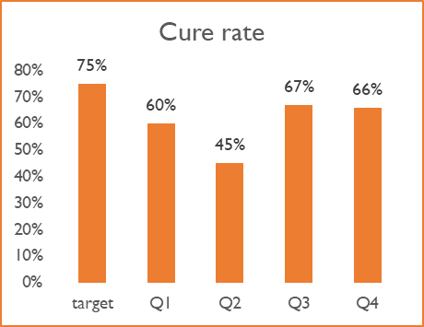
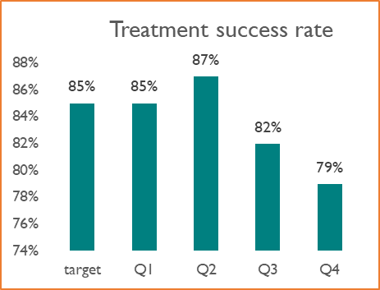
TB OUTCOMES Oct 2019-Sept 2020
Q2 had the highest treatment success rate of 87% but with lowest cure rate 45%. Q3 and Q4 had the lowest treatment success rates but with higher cure rates

Slide 36
MDR TB CASES JULY-SEPT 2020
We registered 8 MDR TB cases
4 cases identified at MRRH and 4 from other facilities
The cases came from the districts of Bushenyi, Kirihura, Ibanda, Ntungamo, Isingiro, Rubirizi, Kanungu and Mbarara each district registering one case

Slide 37
MDR patient outcomes at 24 months
Indicator | Registered | Cured | Completed | Died | Treatment failure
All confirmed RR TB cases | 14 | 7 | 5 | 2 | 0
All confirmed RR TB cases HIV positive | 8 | 4 | 3 | 1 | 0
0-14 | 1 | 0 | 1 | 0 | 0

Slide 38
TPT COMPLETION AT 6MONTHS
-Above 80% of our clients across quarters except Q1 are completing INH.
-Reasons for not completing on next slide

Slide 40
Cummulative TPT INITIATION
YEAR | NUMBER INITIATED ON TPT
2017 | 509
2018 | 1,354
2019 | 6,169
2020 | 1,846
TOTAL | 9,878

Slide 41
KP AND PP SERVICES

Slide 42
KP CASCADE FOR APRIL TO SEPTEMBER 2020
KP Category | NUMBER REACHED | TESTED | NEW POSITIVE | ENROLLED | KNOWN POSITIVE
FSW | 251 | 243 | 6 | 1 | 8
PWID | 25 | 25 | 0 | 0 | 0
MSM | 280 | 278(1 declined) | 3 | 1 | 1
TOTAL | 556 | 547 | 09 | 02 | 09
ACTIVE ON ART 38 FSW & 2 MSM

Slide 43
PP CASCADE FOR APRIL TO SEPTEMBER 2020
PP CATEGORY | NUMBER REACHED | TESTED | NEW POSITIVE | ENROLLED | KNOWN POSITIVE
DISCORDANTS | 43 | 43 | 0 | 0 | 0
MIGRANT WORKERS | 34 | 22 | 0 | 0 | 12
TRUCK DRIVERS | 18 | 6 | 0 | 0 | 12
MILITARY | 17 | 9 | 0 | 0 | 8
FISHING COMMUNITIES | 3 | 1 | 0 | 0 | 2
NIDU | 2 | 2 | 0 | 0 | 0
OTHERS | 6 | 6 | 0 | 0 | 0
TOTAL | 123 | 89 | 00 | 00 | 34

Slide 44
Newly enrolled on PREP

Slide 45
MNCH SERVICES

Slide 46
ANTENATAL CARE VISITS,TESTING AND TIMING
INDICATOR | Jul-20 | Aug-20 | Sep-20
ANC 1st Visit for women | 127 | 170 | 124
Newly tested Negative (TR) | 107 | 141 | 108
Newly tested Positive (TRR) | 2 | 3 | 3
Known negative at entry | 9 | 10 | 0
Known positive at entry | 9 | 16 | 13
ANC 1st Visit for women (1st Trimester) | 32(25%) | 28(17%) | 21(17%)
ANC 4th Visit for women | 99 | 85 | 134
ANC 4+ visits for Women | 115 | 75 | 99
ANC 8 visits for women | 6 | 4 | 5
Total ANC contacts | 647 | 494 | 601
% known HIV status | 100% | 100% | 100%
Comments
19% of pregnant women attending ANC1 came within their 1st trimester
All out mothers have a known HIV status(100%)

Slide 47
MATERNAL ARV UPTAKE
Indicator | Jul-20 | Aug-20 | Sep-20 | OVERALL
POSITIVE MOTHERS (TRR&TRRK) | 11 | 19 | 16 | 46
MOTHERS ON ART | 11 | 19 | 15 | 45
% MATERNAL ARV UPTAKE | 100% | 100% | 94% | 98%

Slide 48
ANC Timing, Syphilis Testing & LLIN Coverage
Indicator | ANC 1st Visit | 1st Trimester | Syphilis Test | Syphilis Positivity | %LLIN
July 2020 | 127 | 25% | 105% | 9.0% | 00%
August 2020 | 170 | 17% | 137% | 4.7% | 00%
Sept 2020 | 124 | 21% | 84% | 3.8% | 00%
Total | 421 | 19% | 111.6% | 5.7% | 00%

Slide 49
MATERNITY SERVICES

Slide 50
Trend of admissions Q1 (Jul-Sept), 2020

Slide 51
Deliveries Q1 (Jul-Sept), 2020
Month | SVD | C-Section | VE | Monthly total Del
Jul | 360 | 391 | 9 | 760
Aug | 353 | 350 | 6 | 709
Sept | 322 | 350 | 9 | 681
Grand Total | 1,035 | 1,091 | 24 | 2,150

Slide 52
C/S rate (Jul-Sept), 2020

Slide 53
Trends of C/S rate: (Jul-Sept),2020

Slide 54
C/S for the referrals Q1,2020

Slide 55
Direct admissions and referrals

Slide 56
Trends of referrals (Jul-Sept), 2020 (%)

Slide 57
Referral sites: Hospitals

Slide 58
Referral sites- HCIV’s

Slide 60
Maternal Death, Q1 2020

Slide 61
Stillbirth Q1, 2020

Slide 62
OUT/INPATIENT

Slide 63
OPD Attendances
Indicator | Oct to Dec 2019 | Jan to Mar 2020 | Apr to Jun 2020 | Jul to Sep 2020
New attendance | 21652 | 17036 | 4221 | 9699
Re-attendance | 18622 | 15936 | 3091 | 2778
Total | 40274 | 32972 | 7312 | 12477
Referrals to unit | 20 | 139 | 20 | 36

Slide 64
INPATIENTS
INDICATOR | Jul-20 | Aug-20 | Sep-20
ADMISSIONS | 2541 | 2398 | 2311
REFERRAL IN | 374 | 196 | 433
REFERRAL OUT | 15 | 6 | 10
RUN AWAY | 20 | 16 | 26

Slide 65
INPATIENT ADMISSIONS AND DEATHS BY WARD
 | Jul-20 |  | Aug-20 |  | Sep-20
Ward Type | ADMISSIONS | DEATHS | ADMISSIONS | DEATHS | ADMISSIONS | DEATHS
Maternity_Obstetric | 804 | 3 | 732 | 3 | 783 | 3
Emergency Ward | 627 | 68 | 581 | 78 | 552 | 52
Paediatrics | 283 | 26 | 300 | 29 | 259 | 21
MaleSurgical | 140 | 2 | 102 | 2 | 149 | 2
Other wards | 109 | 6 | 38 | 5 | 65 | 4
Gynaecology | 104 | 0 | 109 | 3 | 124 | 3
Eye | 89 | 0 | 76 | 0 | 54 | 0
MaleMedical | 82 | 7 | 70 | 5 | 78 | 5
Psychiatric | 79 | 0 | 92 | 0 | 74 | 0
FemaleMedical | 59 | 4 | 91 | 5 | 59 | 3
Palliative | 53 | 3 | 81 | 6 | 0 | 0
FemaleSurgical | 48 | 2 | 68 | 0 | 61 | 0
Intensive Care Unit (ICU) | 30 | 6 | 28 | 11 | 16 | 3
Nutrition | 18 | 1 | 21 | 3 | 19 | 1
TB | 16 | 0 | 9 | 0 | 18 | 0

Slide 66
COVID19 UPDATES

Slide 67
ADMITTTED CONFIRMED COVID19 CASES

Slide 68
COVID19 SAMPLES TAKEN

Slide 69
ALONE WE CAN ACHIEVE SO LITTLE BUT TOGETHER WE CAN ACHIEVE SO MUCH
THANK YOU

